Slide 1
EMPLOYEE DATA ANALYSIS USING MS EXCEL
STUDENT NAME: AKSHAYA NIVASINI JL
REGISTER NO: 312209403
NM ID: asunm1353312209403
DEPARTMENT: B.COM(Accounting & Finance)
COLLEGE: ANNA ADARSH COLLEGE FOR WOMEN

Slide 2

PROJECT TITLE
Employee Performance Analysis using Excel

Slide 3


AGENDA
Problem Statement
Project Overview
End Users
Our Solution and Proposition
Dataset Description
Modelling Approach
Results and Discussion
Conclusion
3/21/2024 Annual Review

Slide 4

PROBLEM STATEMENT
To analyze employee performance data segmented by gender using Microsoft Excel, with the aim of identifying potential gender-based performance disparities, trends, and insights. The goal is to ensure equitable performance evaluation, recognize potential biases, support the development of inclusive performance improvement strategies and derive actionable insights to improve overall workforce efficiency and effectiveness.

Slide 5

PROJECT OVERVIEW
Data analysis is the process of collecting, cleaning, analysing, and visualizing data to discover useful information, inform conclusions, and support decision-making.
By analyzing employee performance data, organizations can identify strengths and weaknesses, address potential issues, and make data-driven decisions to improve workforce productivity. This project aims to leverage MS Excel to perform a detailed analysis of employee performance metrics and provide valuable insights.

Slide 6

WHO ARE THE END USERS?
Employer
Employee
Human Resources (HR) Department
Board of Directors
Management & Executives
Department Heads & Team Leaders

Slide 7

OUR SOLUTION AND ITS VALUE PROPOSITION
CONDITIONAL FORMATTING: MISSING VALUES
FILTERING: REMOVING BALNK CELLS
PIVOT TABLE: EMPLOYEE PERFORMANCE ANALYSIS SUMMARY
CHART: VISUALIZATION OF PERFORMANCE ANALYSIS

Slide 8
DATASET DESCRIPTION
Employee dataset was downloaded from 'Kaggle’
Employee dataset has many features and here are ‘9’:
Employee ID
Name
Business Unit
Employee Status
Employee Type
Employee Classification Type
Gender
Performance Score
Current Employee Rating

Slide 9


THE "WOW" IN OUR SOLUTION
Personalized Views: The pivot table can be integrated into a customizable dashboard where users can create their own views, combining the gender and rating analysis with other relevant metrics such as tenure, job level, or department.
Slicers and Filters: Incorporate slicers and filters that allow users to interact with the data without needing to modify the underlying tables or formulas. Slicers are particularly user-friendly and visually appealing.
3/21/2024 Annual Review
9

Slide 10
MODELLING
DATA COLLECTION:
THE DATA COLLECTION WAS DOWNLOAD IN “KAGGLE”.
FEATURE COLLECTION:
IN THIS DATA BASE IT HAS MANY FEATURES AND I HAD USED 9 FEATURS OF MY PROJECT.
DATA CLEANING:
IN THIS STEP I HAD IDENTIFIED THE MISSING VALUE AND REMOVED THE BLANK.
SUMMARY:
USED PIVOT TABLES FOR EMPLOYEE DATA ANALYSIS.
VISUALIZATION:
I VISUALIZED MY EMPLOYEE DATA ANALYSIS AS “GRAPH”.
10

Slide 11
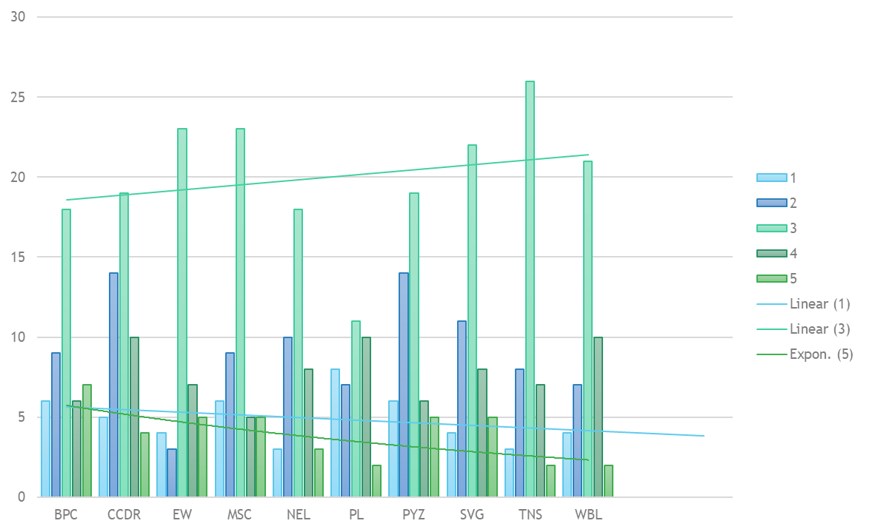
RESULTS
11

Slide 12
CONCLUSION
The data analysis on employee performance using MS Excel has provided valuable insights into the workforce dynamics and individual contributions within the organization. By leveraging Excel's powerful features, including interactive dashboards, advanced conditional formatting, and clear data visualizations, we've been able to identify key performance trends, highlight top performers, and pinpoint areas needing improvement.
Overall, this analysis underscores the importance of data-driven decision-making in human resource management. Excel has proven to be a robust tool for managing and interpreting employee performance data, providing both detailed insights and a clear, strategic overview that supports the organization's goals. Moving forward, these insights can be used to refine performance management strategies, improve employee engagement, and ultimately drive better business outcomes.

